Slide 1
How to solve Industry 4.0
challenges?
Training Area 3 - Hands-on

Slide 2
Lesson Agenda
Introduction to the challenges
The solution proposal template
Individual and team challenges
Resources

Slide 3
Introduction to the challenges

Slide 4
Why solving challenges?
In this last training area of the Planet4 course you will solve industrial challenges using I4.0 enabling technologies.
The objective of these hands-on sessions is to help you through the development of an appropriate Industry 4.0 mindset.
INDUSTRY 4.0 MINDSET
WHERE
I4.0 technologies can be applied
WHY
you should use
I4.0 technologies
WHAT
challenges I4.0 technologies can solve

Slide 5
How the challenges were collected?
The challenges were collected among Planet4 partners and non-partners companies. This allowed us to present you to a wide range of challenges from industrial and business sectors, spanning from wholesale markets and agriculture to shipbuilding and chemical industries.
Notes:
images: Flaticon.com

Slide 6
Types of challenges
When collecting them, the challenges were identified into 3 main typologies:
Monitor and improve the efficiency of production processes: is related to the macro need to improve production processes' efficiency to reduce production costs. In general, industrial processes can be optimized by improving the efficiency of equipment, workforce and supply chain.
Build new products based on AI and IoT technologies: is related to companies who need to build a new generation of products that are typically IoT connected, thus migrating the business toward a service-based solution. Product Innovation actions also aim to improve products' usability by making them easier to use and understand (User Experience redesign).
Another business need: all other needs not identifiable in the 2 previous macro categories of needs.

Slide 7
The solution proposal template

Slide 8
Challenge Based Learning
In this training area you will follow Challenge Based Learning activities adapted to the context of Industry 4.0 by Planet4.
CBL is a collaborative and hands-on approach on learning aimed at solving real-world challenges.
CBL is divided into 3 interconnected phases:
Engage with a challenge.
Investigate to build the foundations of your solution.
Act developing your solution and presenting it to an authentic audience.
To discover more about CBL: https://www.challengebasedlearning.org/

Slide 9
The Solution Proposal Template
The whole process will be guided by a structured template that will represent your main documentation and the final output of this course: the Challenge Solution Proposal.
The template allows you to follow the CBL framework as adopted here, giving you the basic information on how to investigate and solve your challenges.

Slide 10
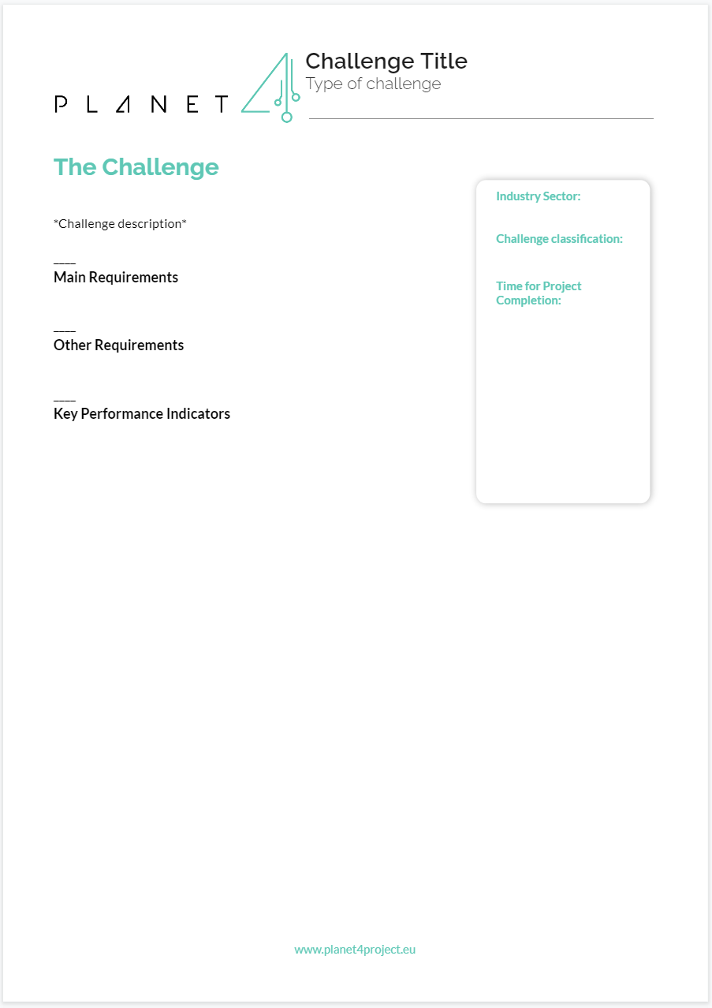
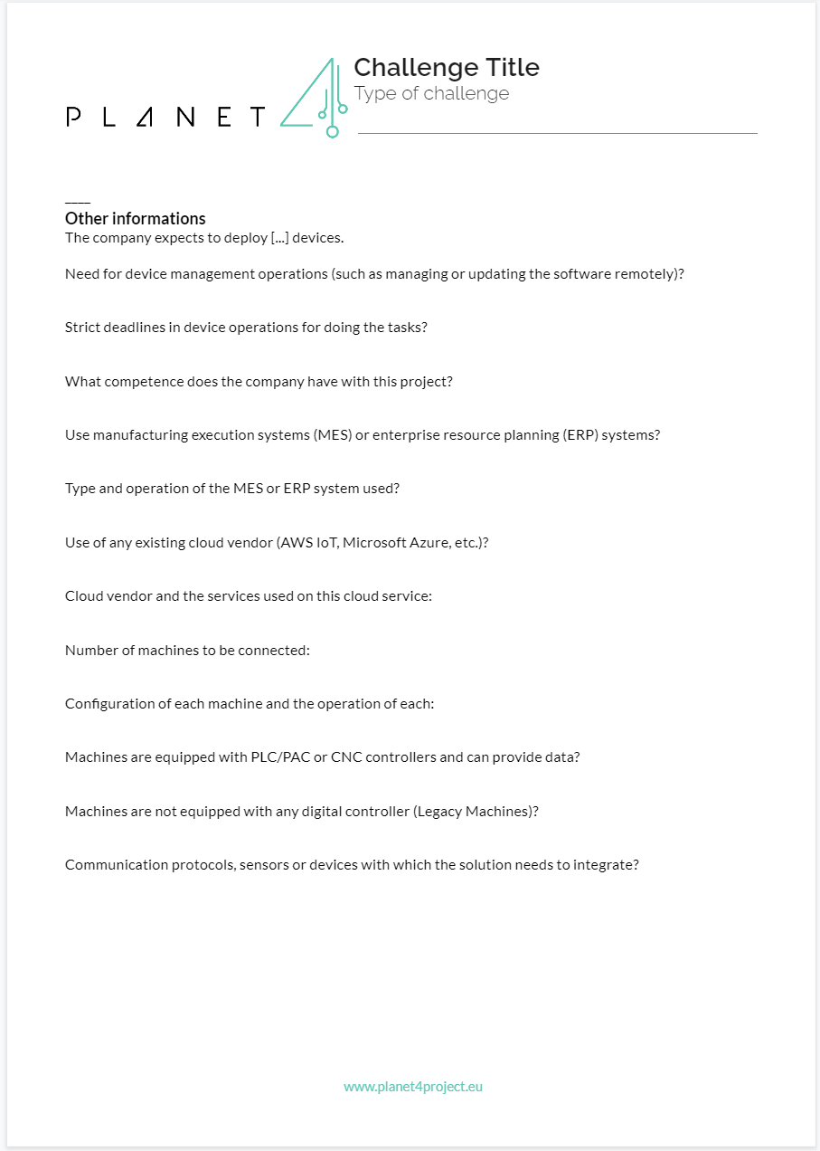
The Challenge
The first section presents you with the challenge: in the first page you can find the main and basic information; in the second one there are other useful information that we collected to help you understand the real context.

Slide 11
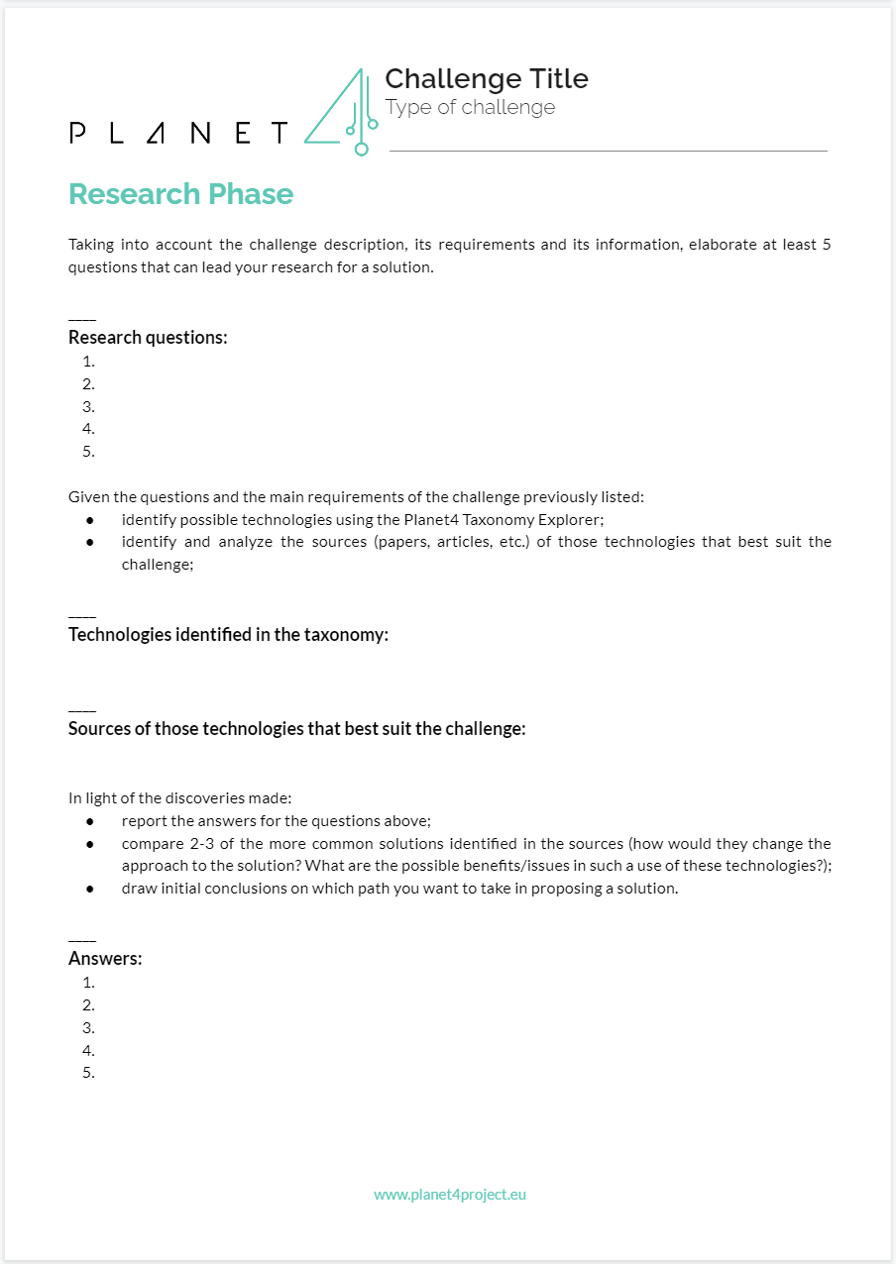
Research Phase
The “Research Phase” section asks you to:
write questions arose from discussing and thinking about the challenge;
use the Planet4 Taxonomy Explorer to identify technologies and sources that solved similar challenges;
give answers to the initial questions;
compare 2-3 of the most common solutions identified in the taxonomy;
briefly describe the path you want to take for the solution drawing some conclusions from the research.

Slide 12
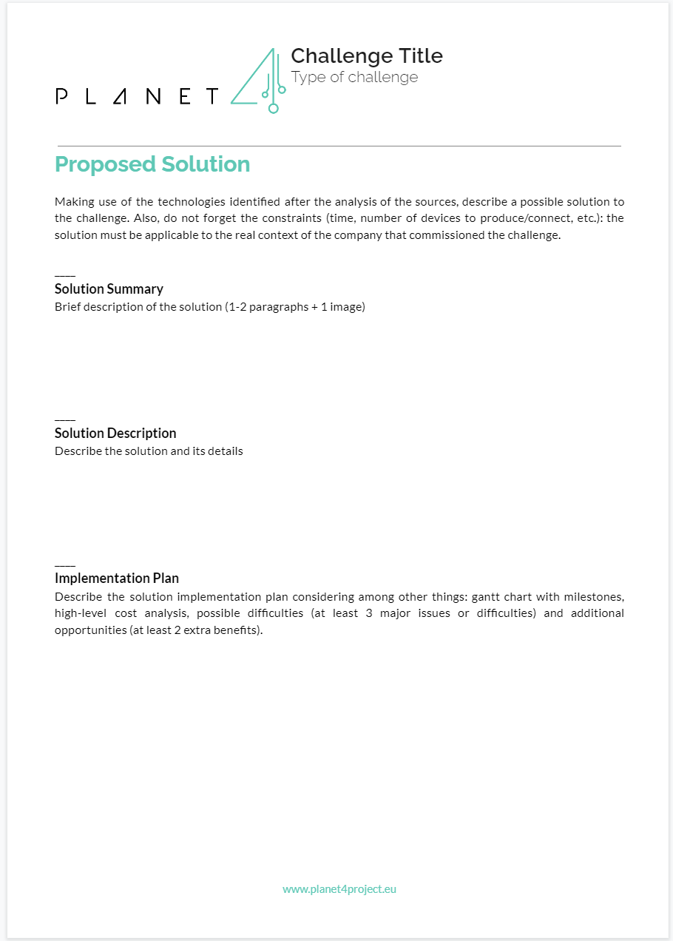
Proposed Solution
The third section asks you to:
write an “executive summary” that briefly describes (also visually) the solution;
write the entire description of the solution with its details;
provide an high-level description of the implementation plan for the solution, also highlighting possible difficulties and additional opportunities.

Slide 13
Individual and team challenges

Slide 14
Individual and team challenges
During this training area you are prompted to work on challenges: first individually, then in a team.

Slide 15
Individual challenge - after this presentation
Each one of you will take one of the given challenges, among the ones selected in the literature or from external companies.
You will work to propose a solution using the template provided.
You will present your solution proposal to other students and teachers in the forums.

Slide 16
Individual challenge - in the next session
A selected number of challenges will be publicly presented during the next in person session, discussing and reviewing them with all learners.
In this way, teachers and learners together will address common pain points and best practices adopted.
After the revision session you will have the possibility to update your solution proposals.

Slide 17
Team challenges
Form teams
After having completed the individual challenge, you will organize yourselves in teams defining your responsibilities (next slides).
This time, you and your team will work together to propose a solution to a challenge provided by a company.
All presentations will be made in front of a company expert.
Challenge assignment
Work on solution proposals
Share progress in the forums
Optional meetings with teachers/tutors
Each team present their proposals
Proposals update & final versions sharing

Slide 18
Team composition
When forming a team keep in mind that no more than 5 members are suggested, taking also into account:
Your fields of study
to have multidisciplinary teams.
Your personal projects
to meet common interests.
Your scheduling needs
so as not to run into planning problems.

Slide 19
Team roles
Some team roles examples taken from the CBL framework guidelines:
Project Manager—Manages the overall process, including keeping track of progress toward meeting project deadlines, team productivity, team morale, and so on.
Documentarian—Develops a structure and strategy for documenting the entire CBL experience through text, audio, and video.
Media Specialist—Manages the production process for all of the media captured during the process. Plans how best to capture, edit, organize, and distribute the media assets.
Product Manager—Responsible for managing the final deliverables including presentations, print materials, web products, videos, and so on.
Research Manager—Manages the development of guiding questions as well as the process and resources necessary for answering them. Collects and organizes content from the researchers. Works with the teacher to organize directed learning experiences and guest lectures when appropriate.
Researcher—Works with the Research Manager to identify activities and gather resources for answering the guiding questions. Assists with documentation and sharing of the answers.
Public Relations/Marketing Director—Keeps all of the stakeholders informed about the CBL process. Creates any necessary marketing materials for the solution.
Social Media/Collaboration Director— Manages the private and public online communities for the project. Works closely with the teacher and other managers to ensure that an online space is available for collaboration and documentation. Recommends, approves, and manages the use of public environments, including social networking and video distribution sites.
https://www.challengebasedlearning.org/project/cbl-guide/

Slide 20
Resources
For the Research Phase:
http://taxonomy.planet4project.eu/
Best practices - collection of solved challenges:
https://www.planet4project.eu/best-practices/

